Slide 1
Plant Monitoring Robot
Presented by:-
Ankita Panpatil
(Finance Round)

Slide 2
Outline
Business model necessity
What is Business Model Canvas?
Purpose of Business Model Canvas
9 Building Blocks
Affiliate Marketing?

Slide 3

Business model necessity
Meet Ankita Panpatil (me). I believe that the idea on which I am working, can change the way how we use Robot.
I am working on Plant Monitoring Robot.
But we have to know :
How to monetize the product?
Who will be the primary customers?
Who will be there partners?
How much money will it take
Notes:
Whether wealthy or not, financial planning is key to experiencing financial success and the achievement of one's life goals (whether these are financial in nature or not).

Slide 4
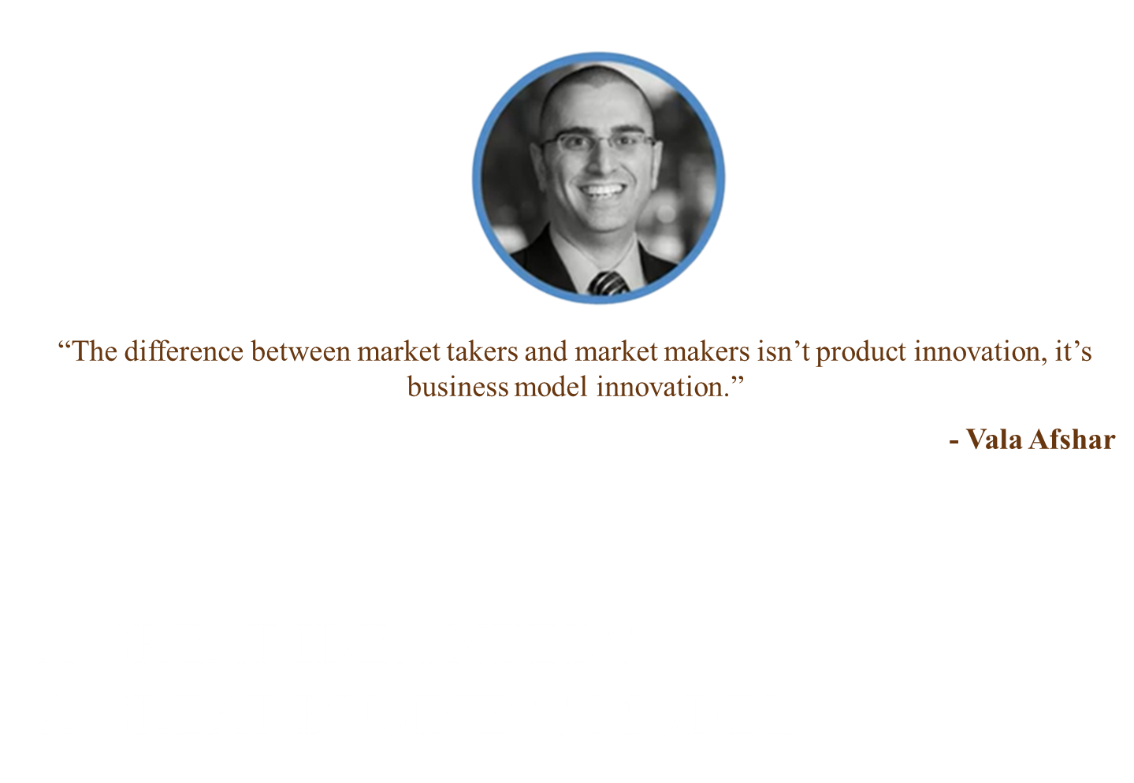
Notes:
The ultimate goal of a financial planner is to guide clients in order to put them in the best possible position to achieve their goals. Yet really understanding what those goals are is not always as obvious as it may seem.

Slide 5

What is Business Model Canvas?
Alex Osterwalder and Yves Pigneur defines Business model as the rationale of how an organization creates, delivers and captures value.
Notes:
Speak each of these points clearly, and repeat them after completing the discussion to reinforce the concepts with the audience members.

Slide 6
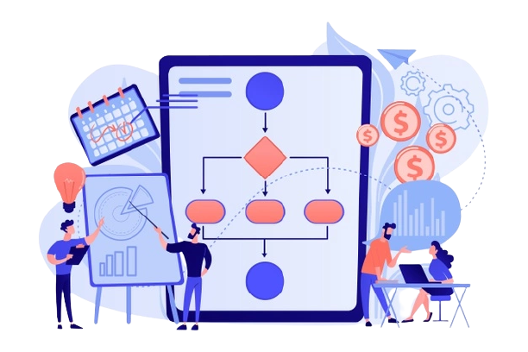
Purpose of Business Model Canvas
Developing new or existing business model.
It help you visualize your idea in simplified manner.
Explore multiple scenarios before implementation.
Help you to pitch your idea.
Notes:
Support this slide by providing audio and visual components such as a wind chime and tree.

Slide 7









9 Building Blocks
Value Proposition
Customer Segmentation
Channels
Customer Relationship
Cost Structure
Revenue Streams
Key Resources
Key Activities
Key Partnership
Notes:
Example: Low Price, uniqueness , lnnovative Design, Secure and Fast Service.
Examples: Website, Shop, Social Media, Global Market, Partners
Examples: Personal Assistance over call, Forums, Groups
Examples: Subscription, Patents, Sales of Service or Physical Product
Examples: Land, Machines, Software , Website, Employees, Financial Resources
Examples: Branding, Marketing, Production, Software Maintenance
Examples: Raw Material Supplier, Global Partner, Promoter
Examples: Salaries, Maintenance

Slide 8

Affiliate Marketing?
How much space do I require for starting the business
What is Affiliate Marketing?
How is Social Media used for Affiliate Marketing?
Notes:
Initially you can start from home as well as online.
Simply, by definition, affiliate marketing is known to be "a marketing arrangement by which an online retailer pays a commission to an external website for traffic or sales generated from its referrals." If you're a beginner or new to the term of affiliate marketing,
Social Media has established virtual networks worldwide amongst all users on it. It has provided a link amongst all of them to share information, images, videos, ideas and all kinds of other content. Affiliate marketing on social media usually makes use of these already existing links that interact and communicate with one another. Participation for affiliate marketers on social media is generally done by creating content with text, images, videos or any other form of content that is made available to people worldwide on the web within seconds.

Slide 9
Thank You!!!!!

Slide 10

Questions

